Slide 1



Data Types and Variables
Types of Operators
SoftUni Team
Technical Trainers
Software University
http://softuni.bg

Slide 2
Table of Content
What is data type
Strings
Numbers
Booleans
Additional Data Types

Slide 3
Have a Question?
sli.do
# fund-python

Slide 4
What is Data Type
Definition and Examples

Slide 5
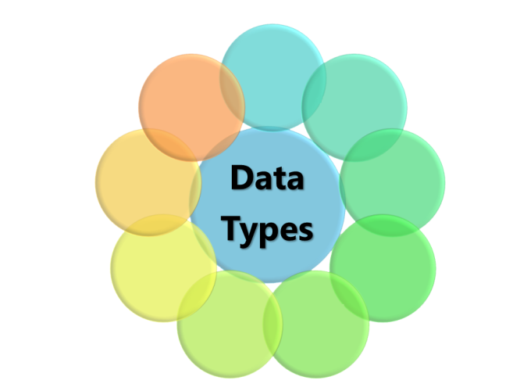
What is Data Type?
A data type, is a classification that specifies which type of value a variable has and what type of operations can be applied to it
In Python we have the following data types:
Numeric Types: int, float, complex
String
List, Set, Tuple, Dictionary
Boolean

Slide 6
Examples
int_num = 10 # int value float_num = 10.2 # float value
a_str = 'Hello world' # str value is_true = True # bool value
list = [123, 'abcd', 10.2, 'd'] # list
dict = {'name': 'red', 'age':10} # dictionary

Slide 7
Data Types are Dynamic
Python is a dynamic language
Variables are not directly associated with any particular value type
Any variable can be assigned (and re-assigned) values of all types:
variable = 42 # variable is now int
variable = 'bar' # variable is now a string
variable = True # variable is now a boolean

Slide 8
'ABC'
Strings
Sequence of Characters

Slide 9
What is a String?
Used to represent textual data
Each element in the String occupies a position in the String
The first element is at index 0, the next at index 1, and so on
The length of a String is the number of elements in it
Accessing element at index
name = 'George'
print(name[0]) #'G'

Slide 10
String Literal
String literals in Python are surrounded by either single quotation marks, or double quotation marks:
'hello' is the same as "hello"
The len() method returns the length of a string
a = "Hello, World!" print(len(a)) # 13

Slide 11

Strings are Immutable
Unlike in languages like C, Python strings are immutable. This means that once a string is created, it is not possible to modify it.
name = 'George'
name[0] = 'P'
print(name) #'George'

Slide 12
String Interpolation
From Python 3.6+ we can use string interpolation. These are string literals that allow embedded expressions.
name = 'Rick'
age = 18
print(f'{name} = {age}') # Rick = 18
Place your variables inside {}

Slide 13
Problem: Concatenate Names
Receive two names as string parameters and a delimiter.
Print the names joined by the delimiter
'John', 'Smith', '->'
John->Smith
'Jan', 'White', '<->'
Jan<->White
firstName = input()
secondName = input()
delimiter = input()
print(f'{firstName}{delimiter}{secondName}')
Check your solution here: https://judge.softuni.bg/Contests/Practice/Index/1721

Slide 14
123
Numbers
Integer, Float

Slide 15
Integer
Int or integer is a whole number, positive or negative, without decimals, of unlimited length
x = 1 # int
y = 231223423352 # int
z = -2312312 # int

Slide 16
Problem: Centuries to Minutes
Write program to enter an integer number of centuries and convert it to years, days, hours and minutes
1 centuries = 100 years = 36524 days = 876576 hours = 52594560 minutes
Centuries = 1
5 centuries = 500 years = 182621 days = 4382904 hours = 262974240 minutes
Centuries = 5
The output is on one row
Check your solution here: https://judge.softuni.bg/Contests/Practice/Index/1721

Slide 17
Solution: Centuries to Minutes
centuries = int(input())
years = centuries * 100
days = int(years * 365.2422)
hours = 24 * days
minutes = 60 * hours
print(f "{centuries} = {years} years = {days} days = {hours} hours = {minutes} minutes")
Tropical year has 365.2422 days
(int) converts float to int
Check your solution here: https://judge.softuni.bg/Contests/Practice/Index/1721

Slide 18
True False
Booleans
Conditions

Slide 19
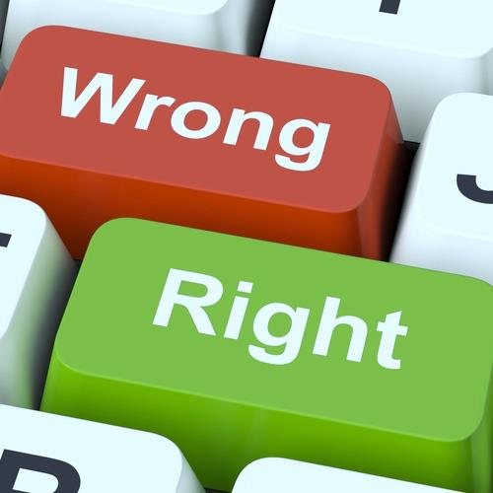
What is a Boolean?
Boolean represents a logical entity and can have two values: True and False
You can use the bool() function to find out if an expression (or a variable) is true:
Or even easier:
print(bool(10 > 9)) # True
print(10 > 9) # True

Slide 20
Comparisons and Conditions
Operator | Description | Example
== | equal | if (day == 'Monday')
> | greater than | if (salary > 9000)
< | less than | if (age < 18)
>= | greater than or equal | if (6 >= 6)
!= | not equal | if (5 != 5)
is | Object identity | n = 'a' m = 'a' n is m # True
is not | negated object identity | n is not m # False

Slide 21
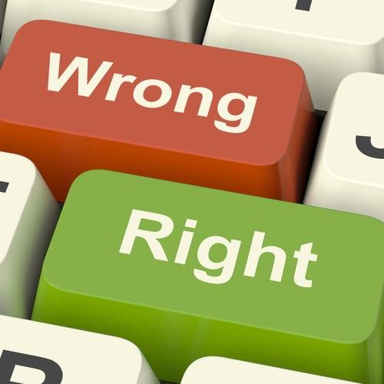
Booleans Examples
Everything with a "value" is True
Everything without a "value" is False
number = 1
if (number):
print(number) # 1
True
number = None
if (number):
print(number)
else:
print('false') # False
False

Slide 22

Booleans Examples (2)
x = 0
bool(x) # False
x = -0
bool(x) # False
x = ''
bool(x) # False
x = False
bool(x) # False
x = None
bool(x) # False

Slide 23
Problem: Special Numbers
A number is special when its sum of digits is 5, 7 or 11
For all numbers 1…n print the number and if it is special
1 -> False
2 -> False
3 -> False
4 -> False
5 -> True
6 -> False
7 -> True
8 -> False
9 -> False
10 -> False
11 -> False
12 -> False
13 -> False
14 -> True
15 -> False
16 -> True
17 -> False
18 -> False
19 -> False
20 -> False
20
Check your solution here: https://judge.softuni.bg/Contests/Practice/Index/1721
Notes:
Solution goes to note

Slide 24
Solution: Special Numbers
n = int(input())
for num in range(1, n+1): sum_of_digits = 0
digits = num
while digits > 0:
sum_of_digits += digits % 10
digits = int(digits / 10)
# TODO: check whether the sum is special
Check your solution here: https://judge.softuni.bg/Contests/Practice/Index/1721

Slide 25
[] {}
Additional Datatypes
List,Tuple,Set,Dict

Slide 26
Definition and Examples
A list contains items separated by commas and enclosed within square brackets
A tuple is a collection which is ordered and unchangeable In Python tuples are written with round brackets
cars = ["Saab", "Volvo", "BMW"]
this_tuple =("apple", "banana", "cherry") print(this_tuple)

Slide 27
Definition and Examples
A set is a collection which is unordered and unindexed. Sets are written with curly brackets.
A dictionary is a collection which is unordered, changeable and indexed. They have keys and values
this_set = {"apple", "banana", "cherry"} print(this_set)
this_dict = { "brand": "Ford", "model": "Mustang" } print(this_dict) # {'brand': 'Ford', 'model': 'Mustang'}

Slide 28
Problem: Meters to Kilometers
Write a program that converts meters to kilometers formatted to the second decimal point.
1852
1.85
789
0.80
Check your solution here: https://judge.softuni.bg/Contests/Practice/Index/1721
Notes:
Solution goes to note

Slide 29
Solution: Meters to Kilometers
meters = int(input())
kilometers = meters/1000
print(f'{kilometers:.2f}')
Check your solution here: https://judge.softuni.bg/Contests/Practice/Index/1721

Slide 30
Problem: Pounds to Dollars
Write a program that converts British pounds to US dollars formatted to 3th decimal point.
1 British Pound = 1.31 Dollars
80
104.800
39
51.090
Check your solution here: https://judge.softuni.bg/Contests/Practice/Index/1721
Notes:
Solution goes to note

Slide 31
Solution: Pounds to Dollars
pounds = int(input())
dollars = pounds * 1.31
print(f'{dollars:.3f}')
Check your solution here: https://judge.softuni.bg/Contests/Practice/Index/1721

Slide 32
None
None keyword

Slide 33
What is None?
The None keyword is used to define a null value, or no value at all
There are two ways to check if a variable is None. One way can be performed by using the is keyword. Another is using the == syntax.
if null_variable is None:
print('null_variable is None')
if null_variable == None:
print('null_variable is None')

Slide 34

Summary
Python supports the following data types:
String
Bool
Int
Float
List, Tuple, Set, Dict
None is nothing
…
…
…

Slide 35
https://softuni.bg/modules/70/fundamentals-module/1197

Slide 36












SoftUni Diamond Partners

Slide 37




SoftUni Organizational Partners

Slide 38




Trainings @ Software University (SoftUni)
Software University – High-Quality Education and Employment Opportunities
softuni.bg
Software University Foundation
http://softuni.foundation/
Software University @ Facebook
facebook.com/SoftwareUniversity
Software University Forums
forum.softuni.bg

Slide 39

License
This course (slides, examples, demos, videos, homework, etc.) is licensed under the "Creative Commons Attribution-NonCommercial-ShareAlike 4.0 International" license

